Slide 1


Getting Started With
Microsoft Access
Database
2
Manager of Information Center
Tendering Department
Arab Contractors
Said Fawzy

Slide 2
Getting Started With
Microsoft Access
Database
2
Explore MS Access
Manager of Information Center
Tendering Department
Arab Contractors
Said Fawzy

Slide 3

1
What is MS Access
2
Creating and Exploring Database
3
Some Access Terminology
4
Access Objects and the 3 tier layers of database

Slide 4

What is Microsoft Access?

Slide 5
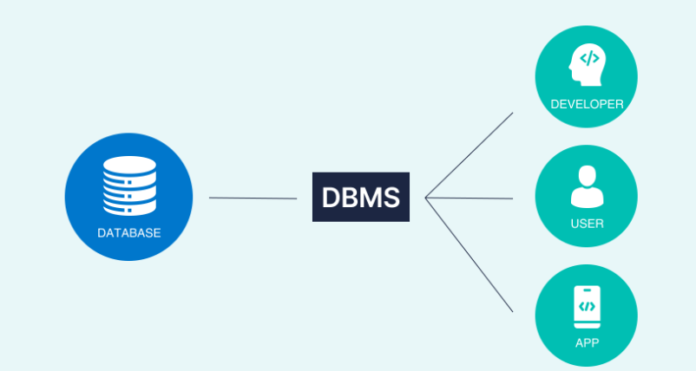


Microsoft Access is a database management system (DBMS) from Microsoft

Slide 6
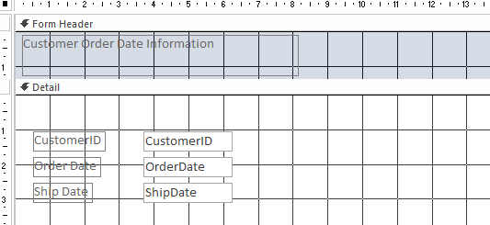
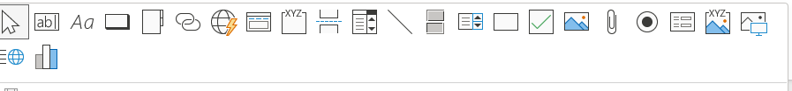
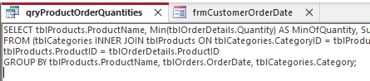
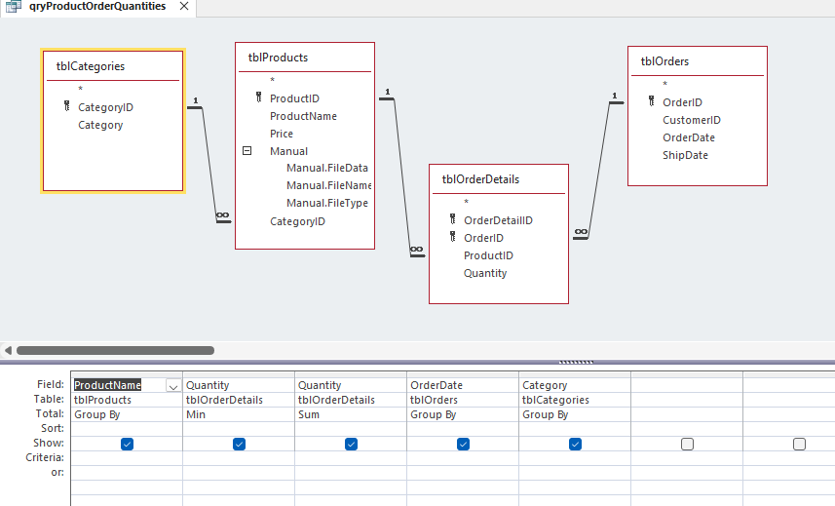
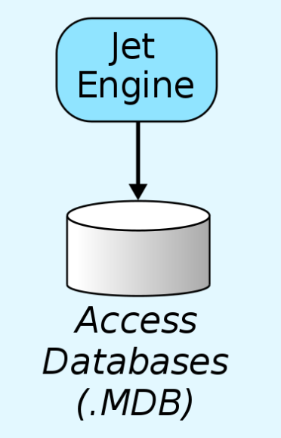
software-development tools
a graphical user interface
Microsoft Access combines :
Relational Access Database Engine (ACE)

Slide 7
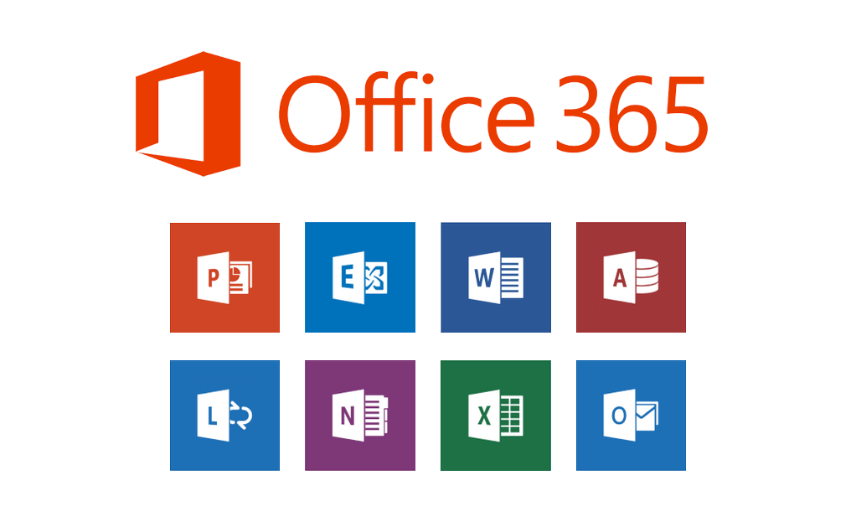
It is a member of the Microsoft 365 suite of applications, included in the Professional and higher editions or sold separately.

Slide 8

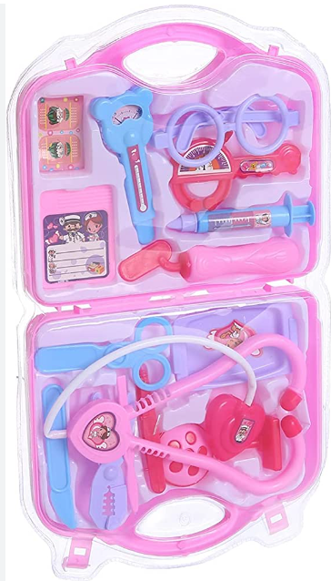


It might look like

Slide 9

But It is still
strong
popular
easy
Database

Slide 10
Access Database Example
Tenders DB
Cost Control Program
Bid Bow Construction Estimating Software (Canada).
Competitors Analysis as a web application in 2001

Slide 11
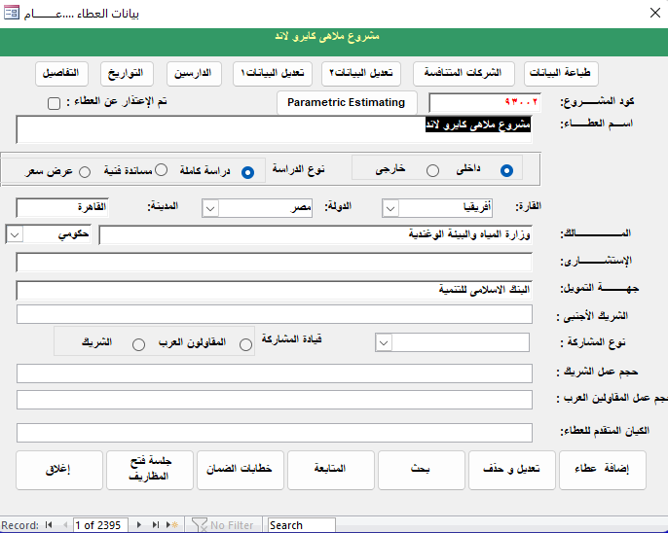
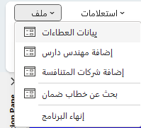

Tenders

Slide 12
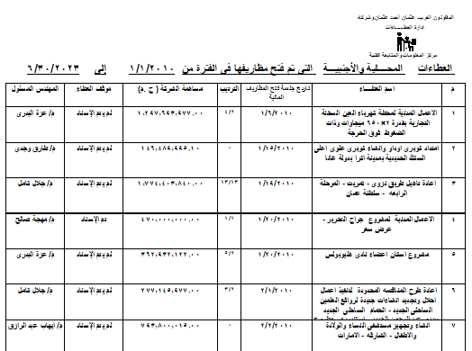
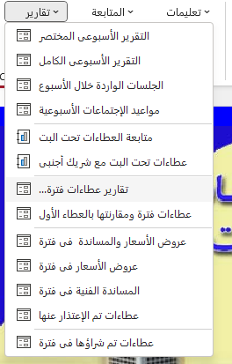
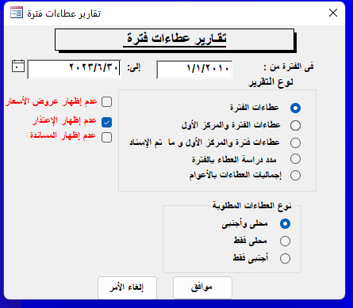
Tenders

Slide 13
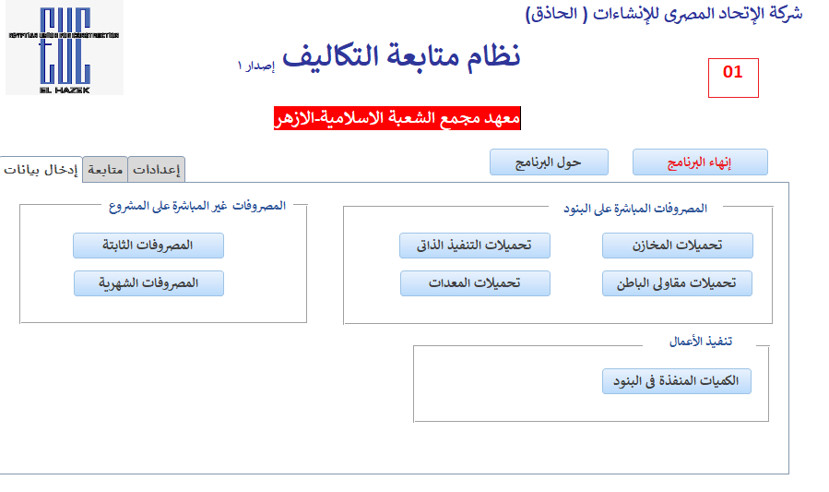
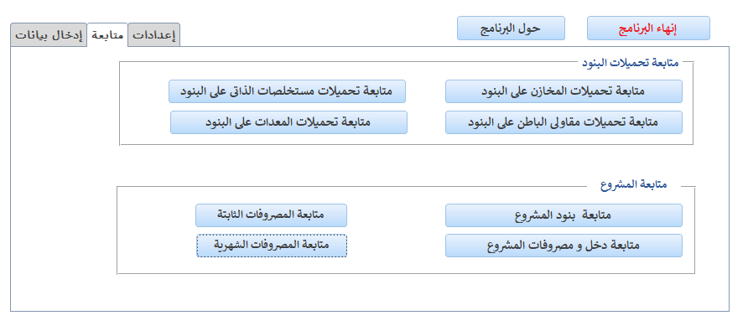
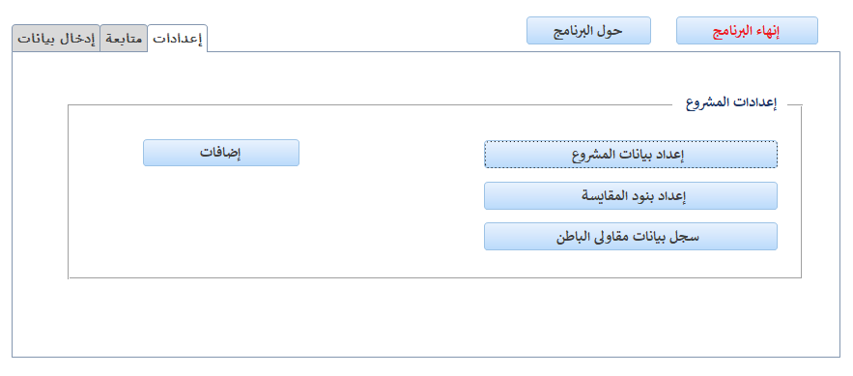
Cost Control

Slide 14
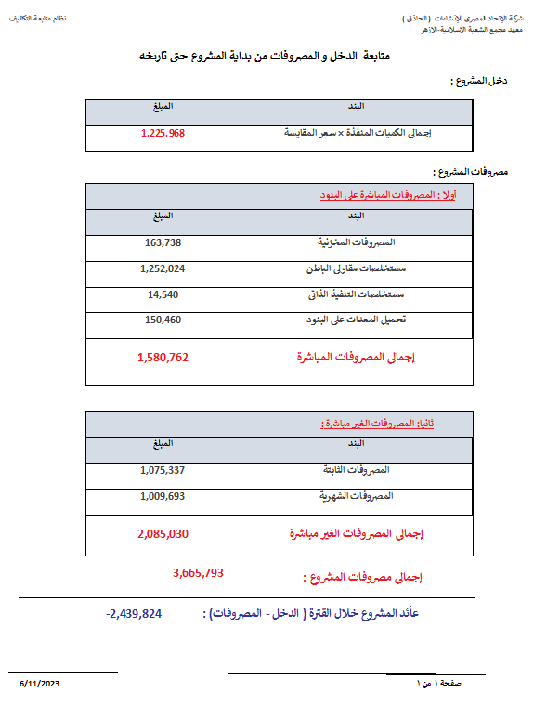
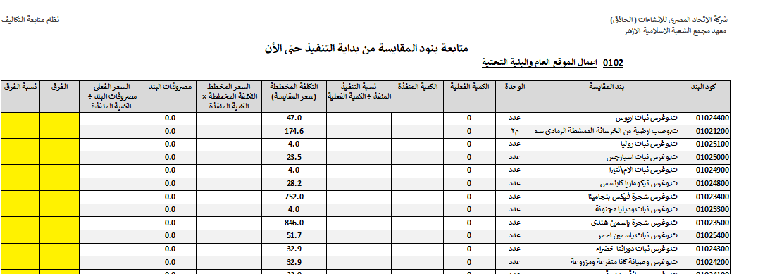
Cost Control

Slide 15



Slide 16
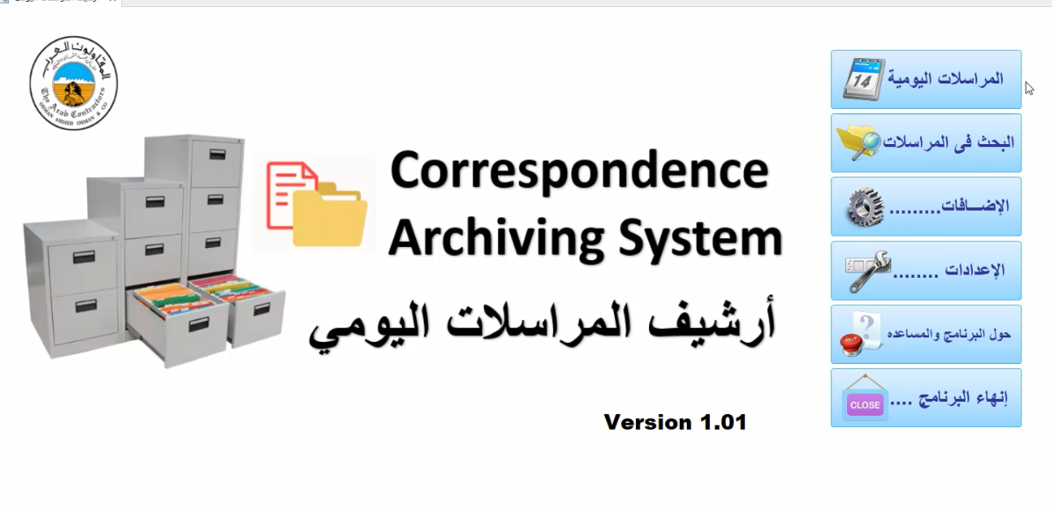

Slide 17
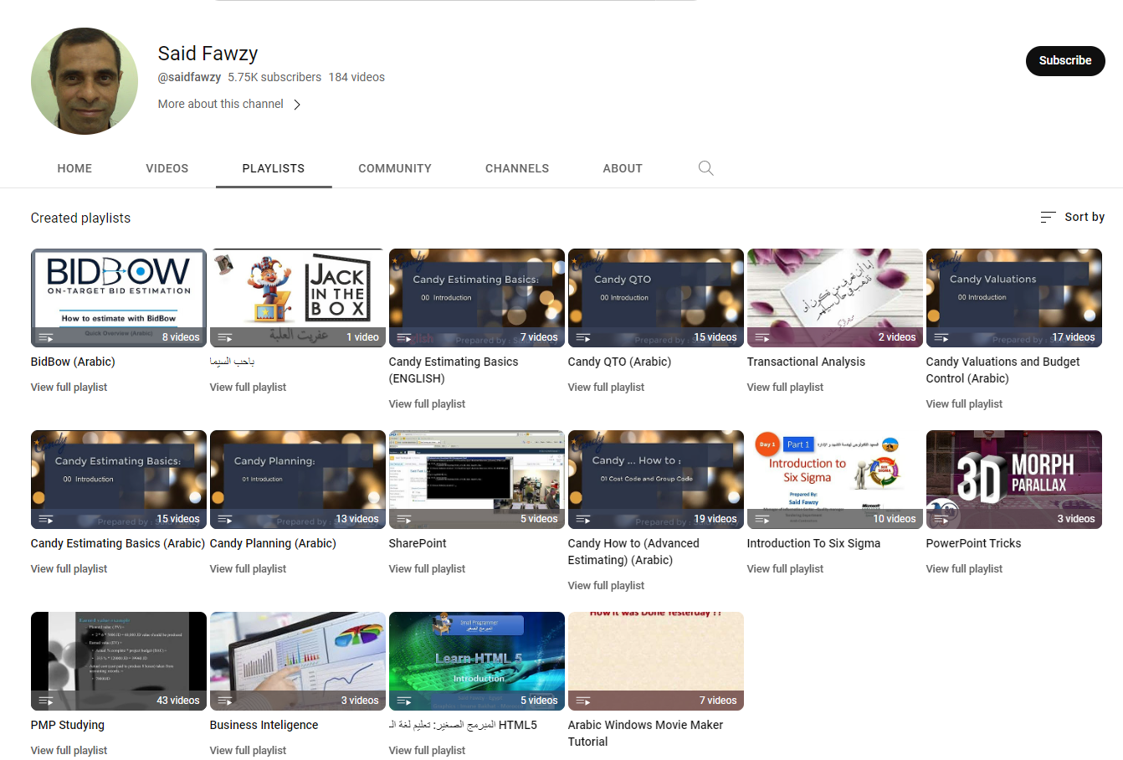
https://www.youtube.com/user/saidfawzy
BidBow

Slide 18
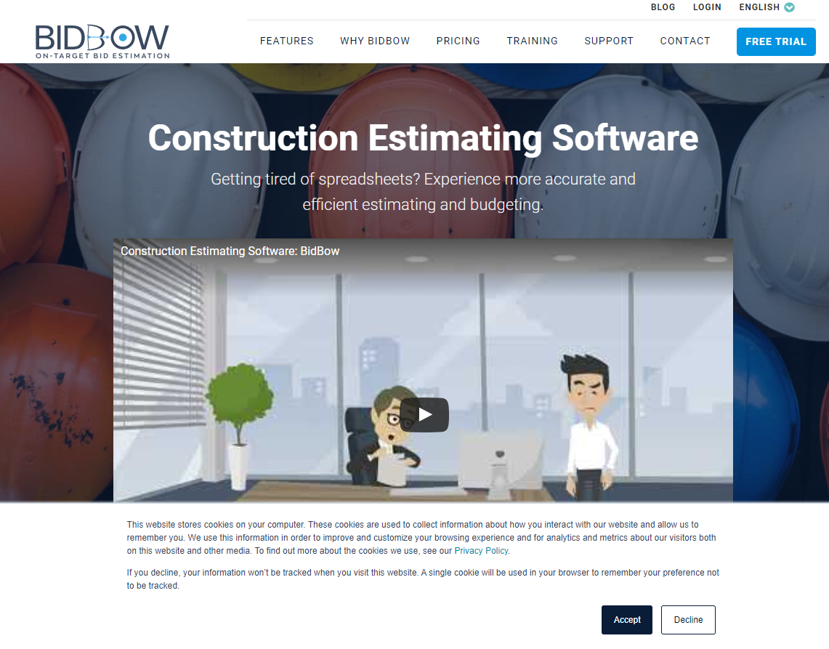
BidBow
https://www.bidbow.com

Slide 19
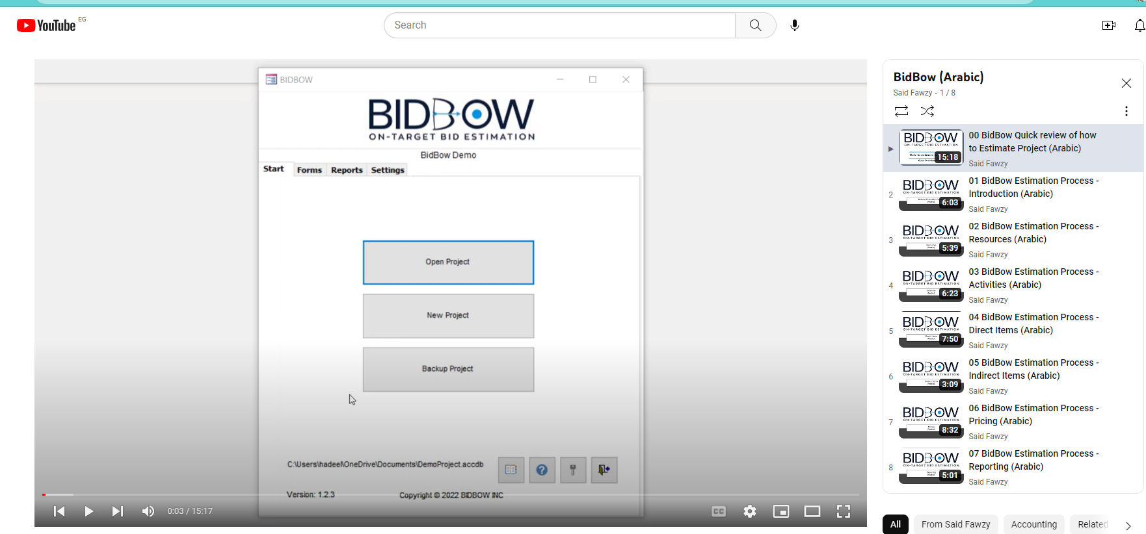

Slide 20
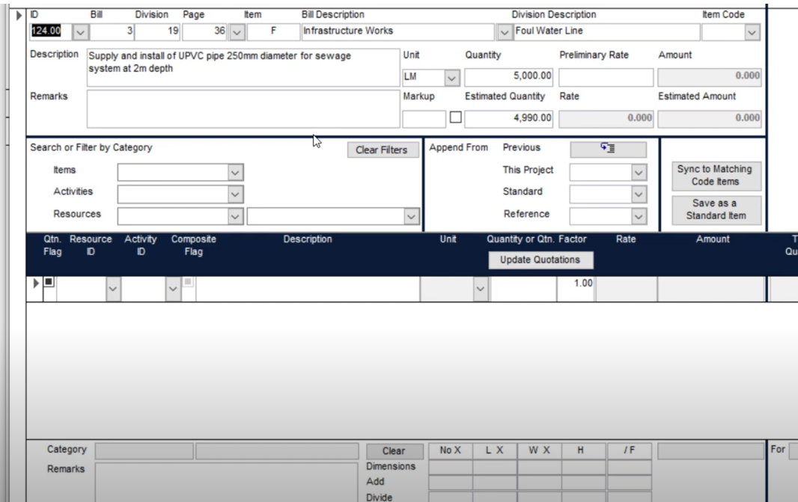

Slide 21
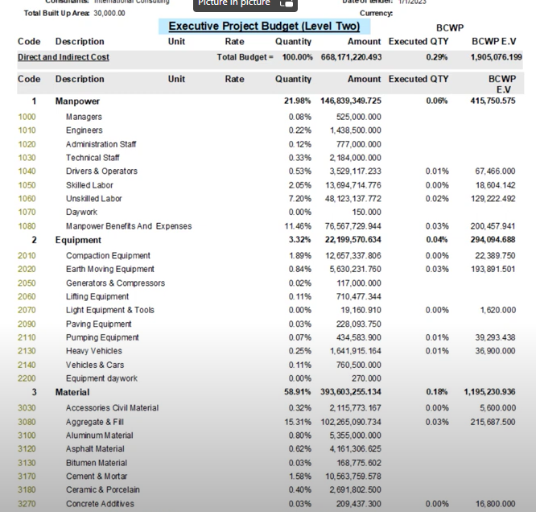

Slide 22
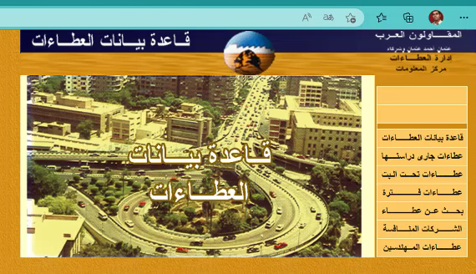
Web Application
Competitors Analysis 2001

Slide 23

1
Creating New Database

Slide 24

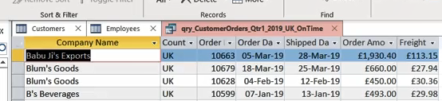
Lab 1A: Exploring Database

Slide 25

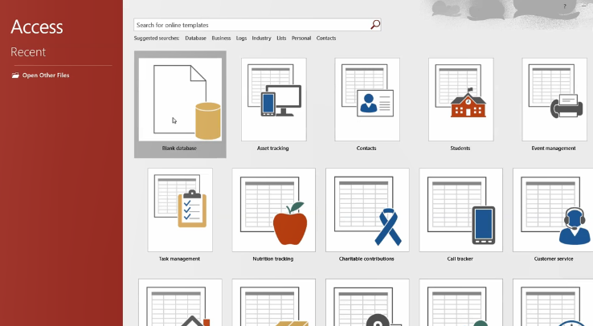
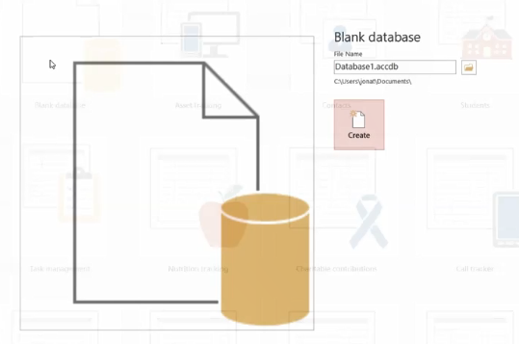
Lab 1A

Slide 26
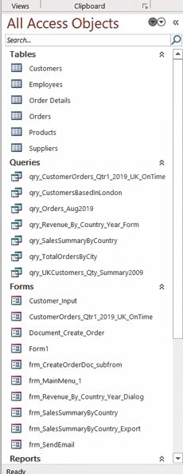
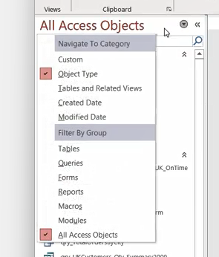
Lab 1A

Slide 27
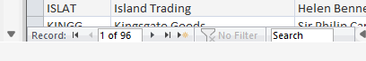
Lab 1A

Slide 28
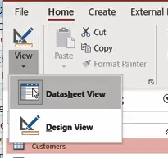
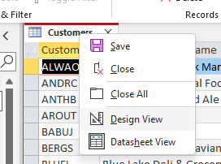
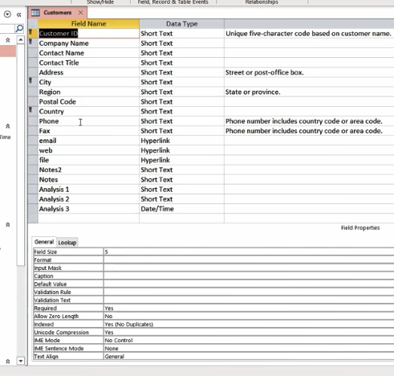
Lab 1A

Slide 29
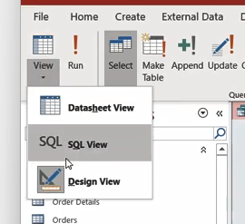
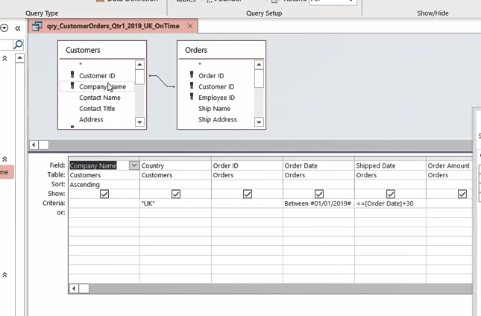
Lab 1A

Slide 30
Lab 1B: Creating Database from a Template

Slide 31
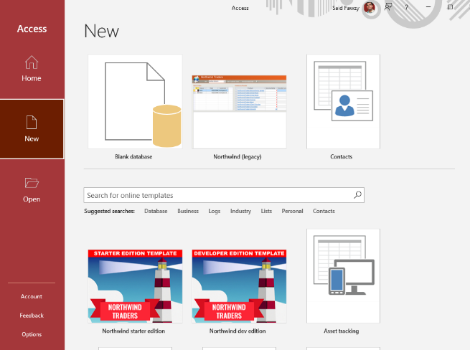
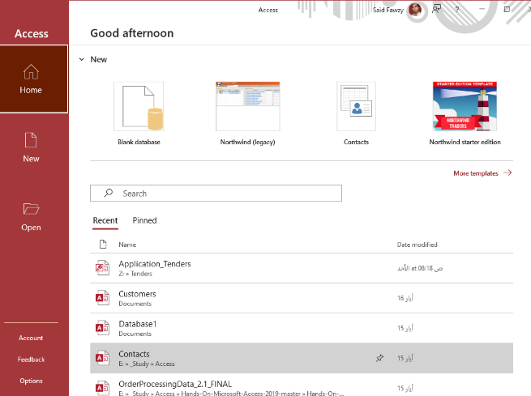
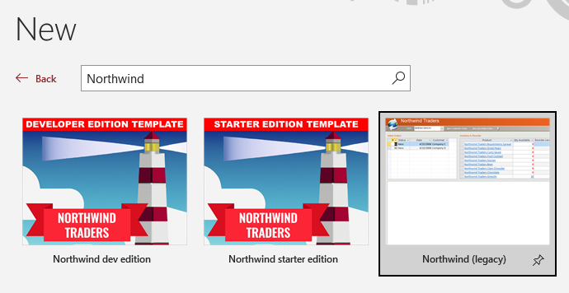
Lab 1B

Slide 32
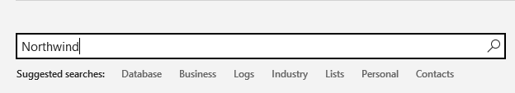
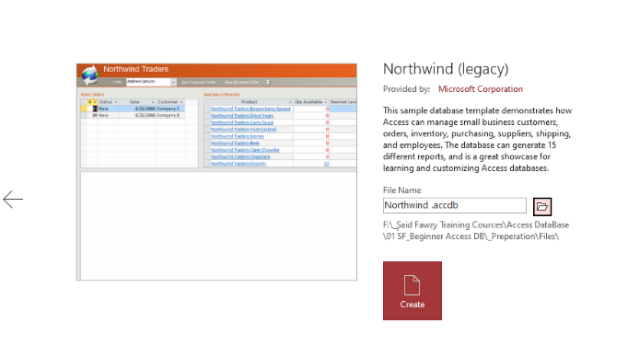
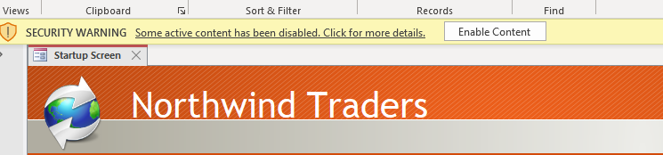
Lab 1B

Slide 33
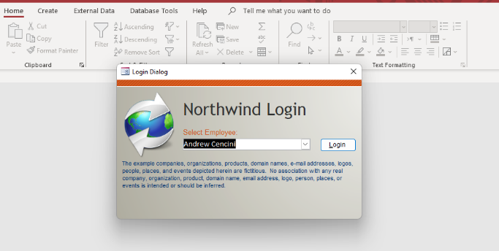
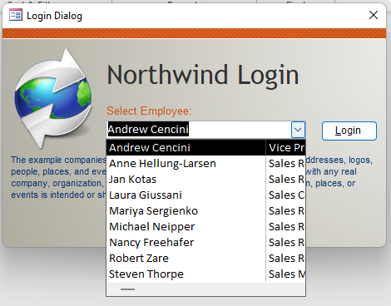
Lab 1B

Slide 34
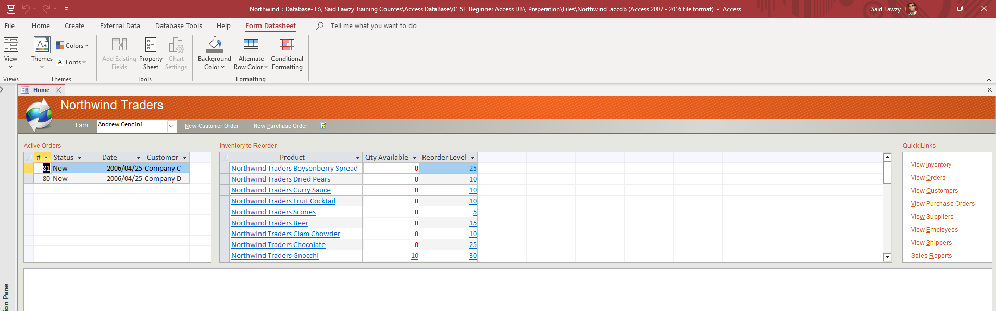
Lab 1B

Slide 35
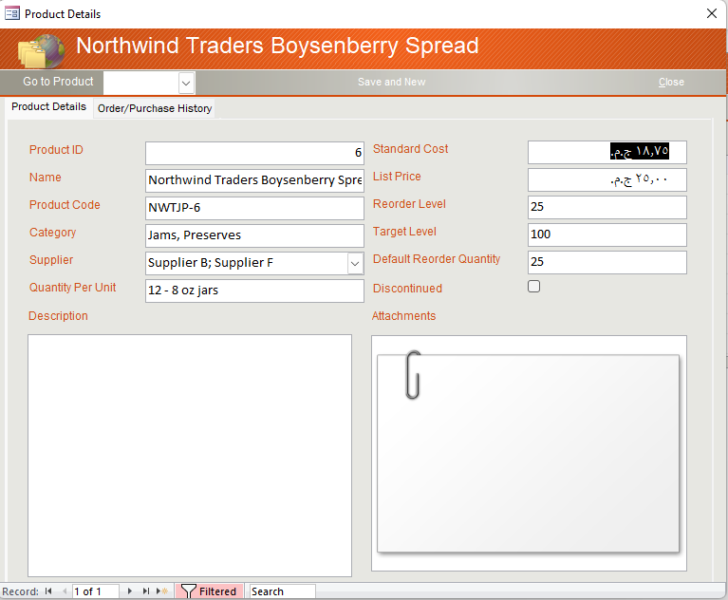
Lab 1B

Slide 36
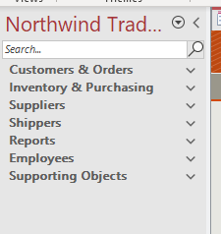
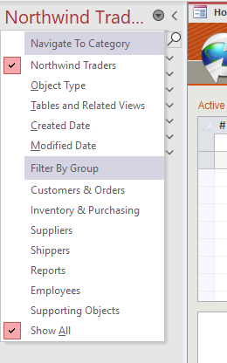
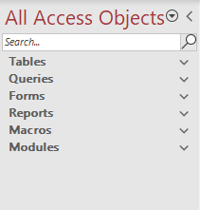
Lab 1B

Slide 37
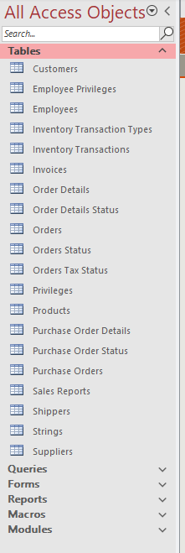


Lab 1B

Slide 38



Lab 1B

Slide 39


Lab 1B

Slide 40


Lab 1B

Slide 41



Lab 1B

Slide 42


Lab 1B

Slide 43

Lab 1B

Slide 44


Lab 1B

Slide 45


Lab 1B

Slide 46



Lab 1B

Slide 47

Some Access Terminology

Slide 48

Access Objects and the 3 tier layers of database

Slide 49
Task: Be a RDMS for 10 minutes

Slide 50


Task 2 : Be A RDBMS for 10 Minutes
Job : We need to record Employees Data

Slide 51



Emp
بيانات سعيد فوزى

Slide 52


Constraints
Emp
PK
INSERT
Required
UPDATE
Unique

Slide 53

Constraints
Emp
PK
INSERT
Required
UPDATE
Unique

Slide 54

Emp
INSERT

Slide 55

Emp
INSERT

Slide 56
Emp
INSERT

Slide 57
Emp
INSERT

Slide 58
Emp
INSERT

Slide 59


Slide 60




Emp
الإسكندرية

Slide 61


Emp

Slide 62

Emp
Towns

Slide 63
Constraints
Emp
Towns
PK
Required
Unique

Slide 64



Emp
Towns
FK
PK
INSERT
Constraints
UPDATE
DELETE

Slide 65
Emp
Towns
FK
PK
INSERT
Constraints
UPDATE
DELETE

Slide 66
Emp
Towns

Slide 67
Emp
Towns

Slide 68


Emp
Towns

Slide 69
Emp
Towns
DELETE
We have no Orphans

Slide 70



Towns
1
Emp

Slide 71


Towns
Jobs
1
1
Emp

Slide 72


Slide 73


Said Fawzy

